Slide 1

Web scraping to gain company insights

Slide 2
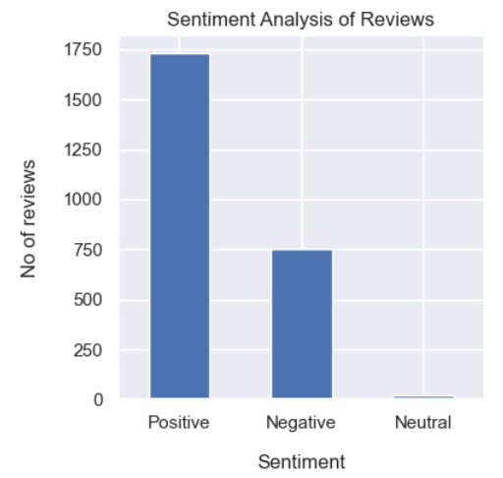
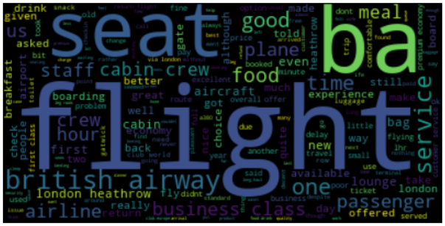
INSIGHTS FROM CUSTOMER REVIEWS
From cleaning 2500 reviews given by the customers, we obtained
Positive Reviews - 1731
Negative Reviews - 751
Neutral Reviews – 18
Word cloud of keywords used in reviews

